Slide 1

Performance Analysis of AI Enabled Healthcare Chatbot
By Gude Reddy Leela(22BFA32036) Lavanya Sangaraju (22BFA32060) Maneesh Kumar (22BFA32001) Akkili Geyasree (22BFA32004)
Under the Guidance of:
M.Sai Kumar (MTech)
Asst proff
DEPARTMENT OF COMPUTER SCIENCE AND ENGINEERING (Data Science) SRI VENKATESWARA COLLEGE OF ENGINEERING (Autonomous) Karakambadi Road, Tirupati – 517507 Batch: 2022 – 2026

Slide 2
OUTLINE
Abstract
Introduction
Problem Statement
Existing System
Disadvantages
Proposed System
Advantages
System Requirements
Modules
System Architecture
UML Diagram
Screenshots
Conclusion
References

Slide 3
ABSTRACT
This project presents an AI-powered healthcare chat assistant that is designed to provide quick and intelligent medical support to users.
The system interacts with users through a chatbot interface and understands their queries using advanced AI models.
Instead of using traditional rule-based methods, this system uses Large Language Models such as Ollama (gemma:2b) for local processing and OpenAI GPT-4 as a backup to ensure better accuracy and reliability.
The chatbot supports multi-session conversations, which means users can have multiple chats and view their history at any time.
The backend of the system is developed using Java Spring Boot with JWT-based authentication, and the frontend is built using React and Tailwind CSS. MySQL is used as the database to store user data, chat history, and appointments.
Overall, this system helps improve healthcare accessibility, reduces response time, and provides a smart and efficient digital healthcare solution.

Slide 4
INTRODUCTION
Access to healthcare services is limited in many areas, especially for quick medical consultation.
People often need immediate guidance before visiting a doctor but lack reliable solutions.
AI-powered healthcare assistants provide instant and intelligent responses without physical consultation.
This project implements a modern full-stack system using Spring Boot and React with AI integration.
The system uses LLM-based processing instead of traditional NLP to provide accurate and human-like responses.
It also supports multilingual communication and voice interaction for better accessibility.
Additionally, it integrates location services and role-based dashboards for real-world usability.

Slide 5
PROBLEM STATEMENT
Many people do not receive timely medical assistance due to high costs and limited availability of doctors.
Users often struggle to get quick and reliable medical advice based on symptoms.
Existing systems do not provide intelligent, real-time, and personalized responses.
They also lack features like multilingual support, voice interaction, and session-based chat history.
Users face difficulty in finding nearby hospitals during emergencies.
Traditional systems are not scalable and fail to provide modern AI-based solutions.
Hence, there is a need for a full-stack AI-powered healthcare assistant system.

Slide 6
EXISTING SYSTEM
Existing healthcare chatbot systems are mostly rule-based and depend on predefined responses, so they cannot understand complex user queries properly.
They do not use advanced AI models like LLMs, which results in less accurate and non-intelligent responses.
These systems lack important features such as multi-session chat, chat history storage, bilingual communication, and voice interaction.
They also do not support emergency detection or provide alerts in critical situations.
Additionally, existing systems do not include location-based services to find nearby hospitals or doctors, and they do not have role-based access for patients, doctors, and admins.
Due to these limitations, existing systems are less efficient, less interactive, and not suitable for modern healthcare applications.

Slide 7
DISADVANTAGES
Existing systems have limited understanding as they are mostly rule-based and cannot handle complex queries.
They do not use advanced AI models, resulting in less accurate and non-intelligent responses.
They lack features like multi-session chat, chat history, and bilingual communication.
Voice interaction is not supported, making them less user-friendly.
There is no emergency detection to handle critical situations.
They do not provide nearby hospital or doctor suggestions using location services.
They also lack role-based access for patients, doctors, and admins. Overall, these systems are less efficient, less interactive, and not suitable for modern healthcare needs.

Slide 8
PROPOSED SYSTEM
The proposed system is a full-stack AI-powered healthcare chat assistant developed using Spring Boot and React.
It uses advanced AI models like Ollama (gemma:2b) and GPT-4 to provide accurate and intelligent responses.
The system supports multi-session chat with history, bilingual communication (English and Telugu), and voice interaction.
It includes emergency detection to alert users in critical situations.
It also provides nearby hospital and doctor suggestions using location services.
Role-based access is implemented for patients, doctors, and admins to manage appointments, users, and analytics.

Slide 9
ADVANTAGES
Provides accurate and intelligent responses using advanced AI models.
Supports multi-session chat with chat history.
Offers bilingual communication in English and Telugu.
Includes voice interaction for better user experience.
Detects emergency situations and alerts users.
Provides nearby hospital and doctor suggestions.
Implements secure role-based access for patients, doctors, and admins.
Scalable, efficient, and suitable for modern healthcare applications.

Slide 10
SYSTEM REQUIREMENTS
Hardware: • Processor: Intel i3 or above • RAM: 4 GB or higher • HDD: 500 GB or more • Internet: Required
Software: • Backend: Java 17, Spring Boot 3.2 • Frontend: React 18, Vite, Tailwind CSS • Database: MySQL 8 ( health care_db ) • AI: Ollama (gemma:2b), OpenAI GPT-4 • APIs: OpenStreetMap Overpass API • Tools: VS Code

Slide 11
MODULES OF HEALTHCARE CHATBOT
1. AI Chat Module: • Generates intelligent responses using Ollama and GPT-4 • Supports multi-session chat with history • Provides bilingual and real-time interaction
2. Authentication Module: • Handles user registration and login • Implements JWT-based security • Provides role-based access control
3. User Management Module (Patient & Doctor): • Manages user profiles and data • Handles appointment booking and tracking • Enables doctors to view patients and generate SOAP notes

Slide 12
MODULES OF HEALTHCARE CHATBOT
4. Admin Module: • Manages users and system data • Monitors chat and appointment activities • Provides analytics dashboards
5. Location & Emergency Module: • Detects emergency keywords and alerts users • Provides nearby hospital and doctor suggestions • Uses location services (OpenStreetMap API)

Slide 13
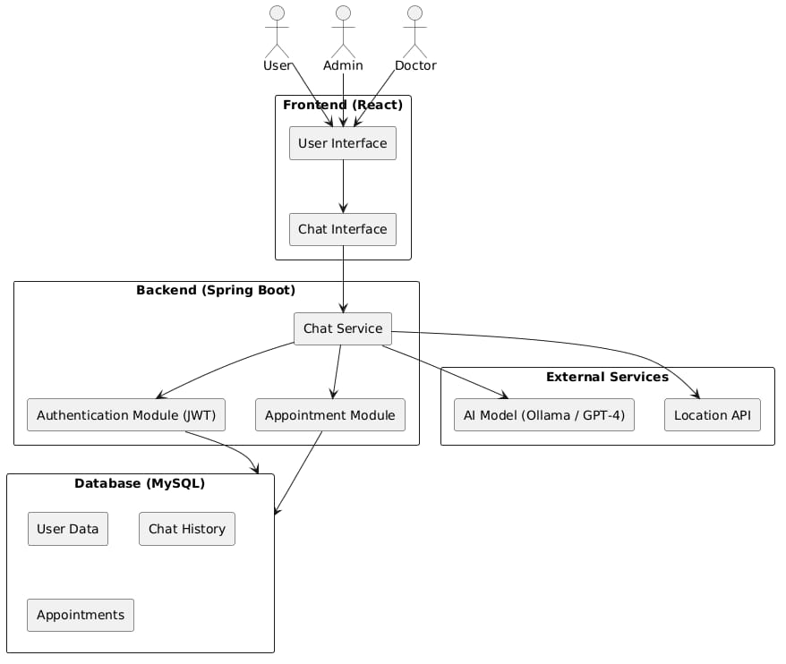
SYSTEM ARCHITEXTURE

Slide 14
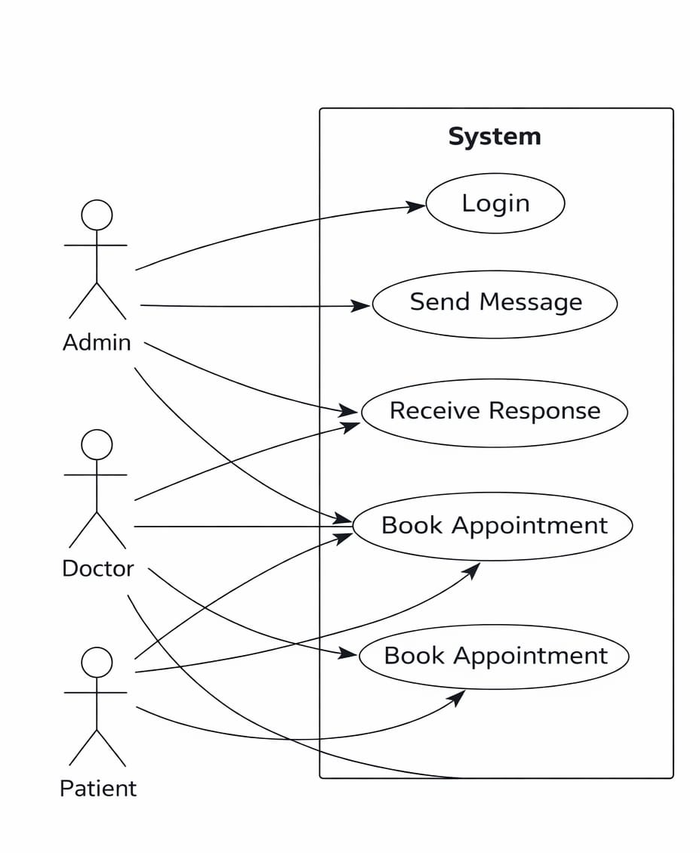
UML Diagram
1. Use Case Diagram
Shows how different actors(users) interact with the AI Healthcare Chatbot system.

Slide 15
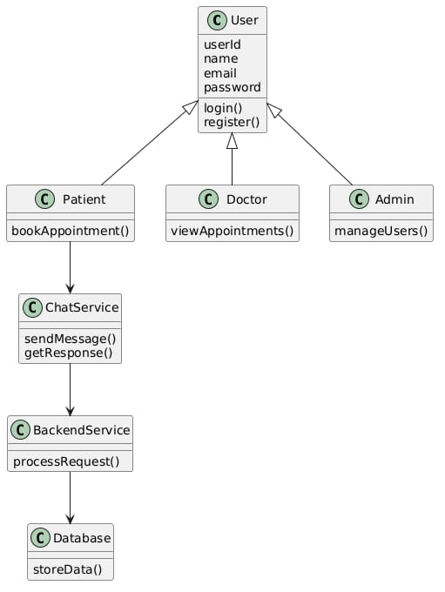
UML Diagram
2.Class Diagram:
Represents the structure of system classes and their relationships.

Slide 16
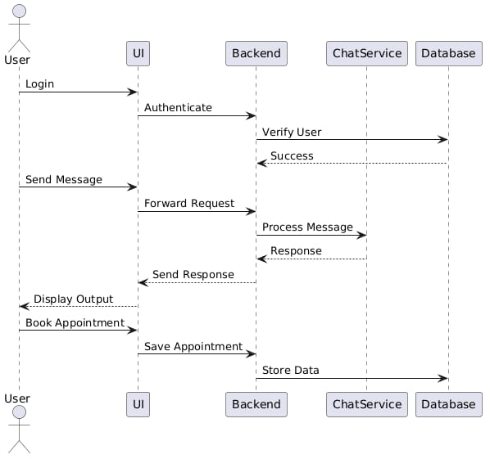
UML Diagram
3.Sequence Diagram
• Shows the step-by-step interaction between system components.

Slide 17
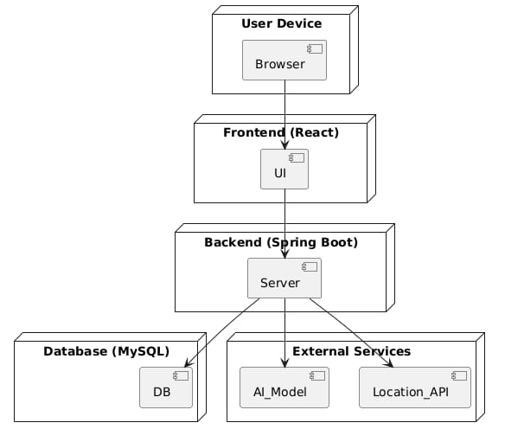
UML Diagram
4. Deployment Diagram
• Describes the physical architecture of the system.

Slide 18
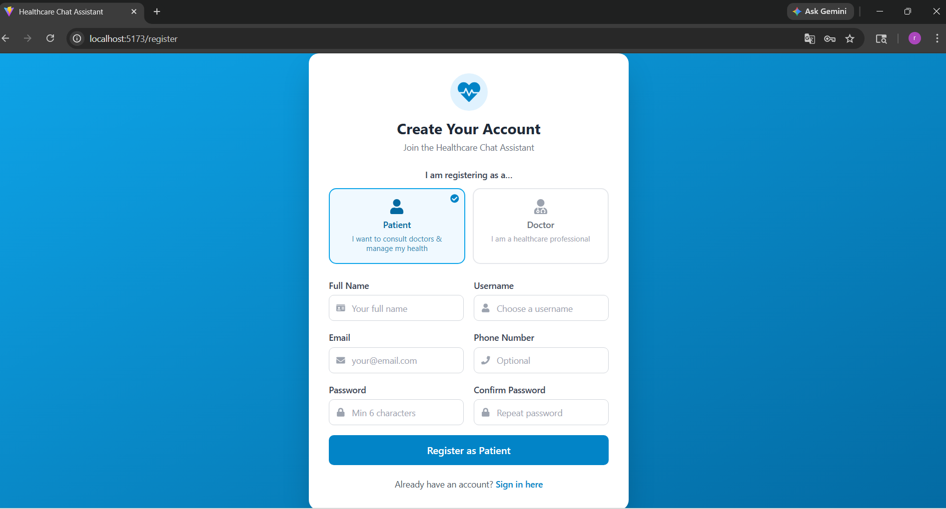
Output
Login/Registration page:

Slide 19
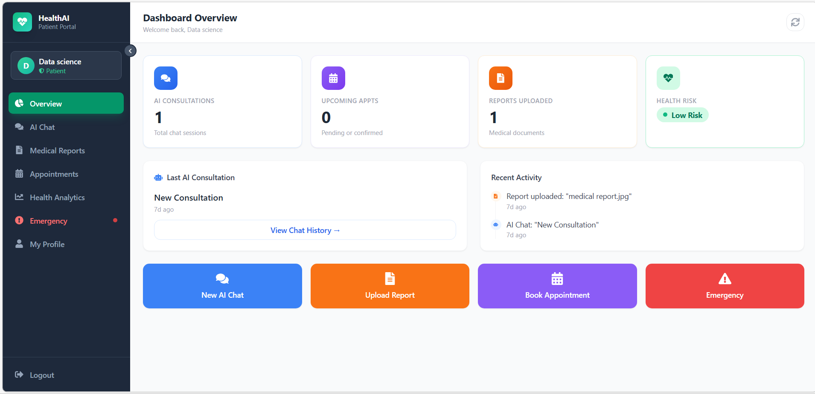
OUTPUT
User(Patient) Page:

Slide 20
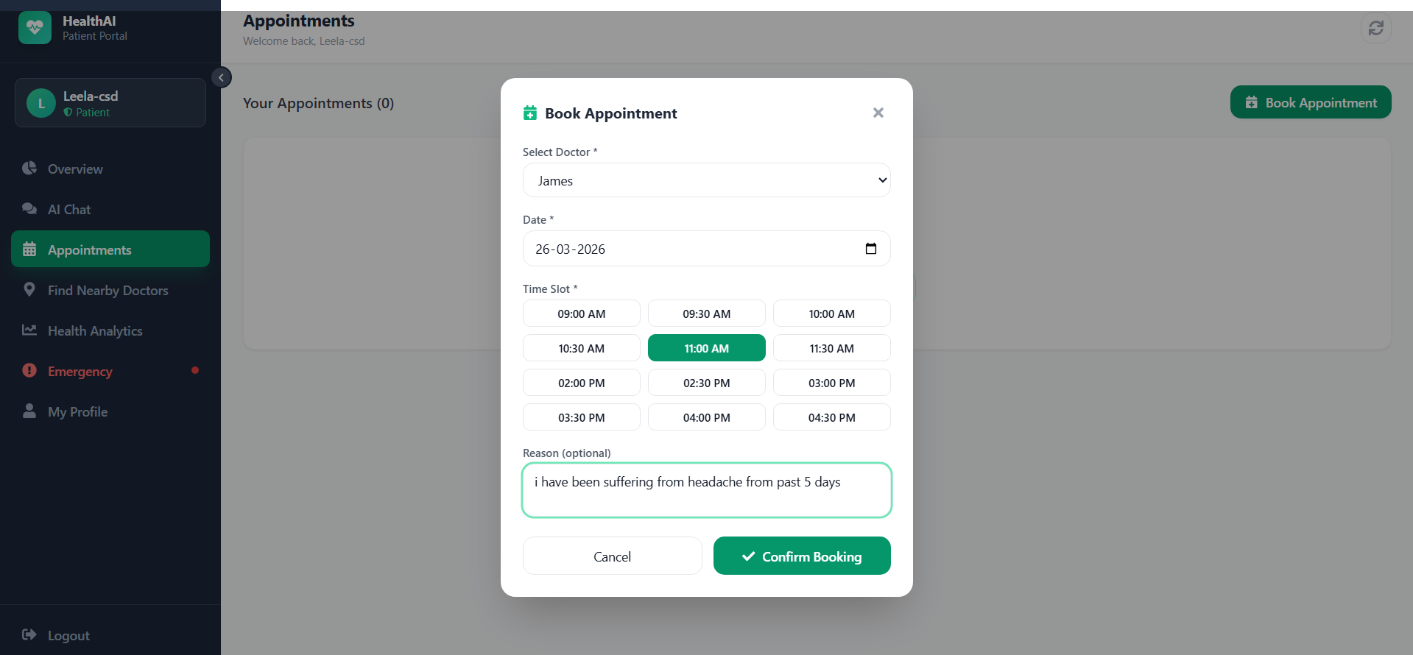
OUTPUT
User(Patient) Page:

Slide 21
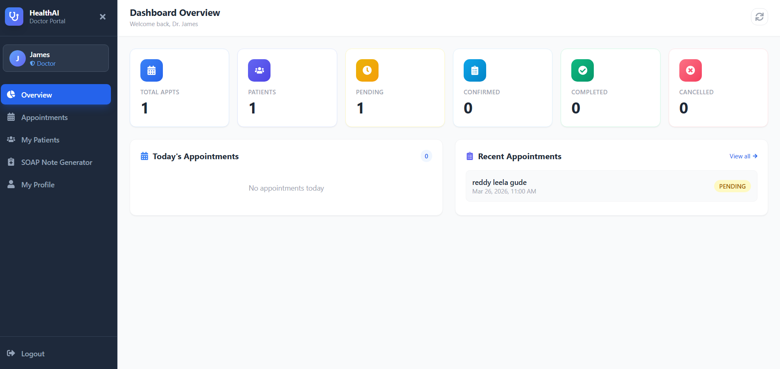
OUTPUT
User(Doctor) Page:

Slide 22
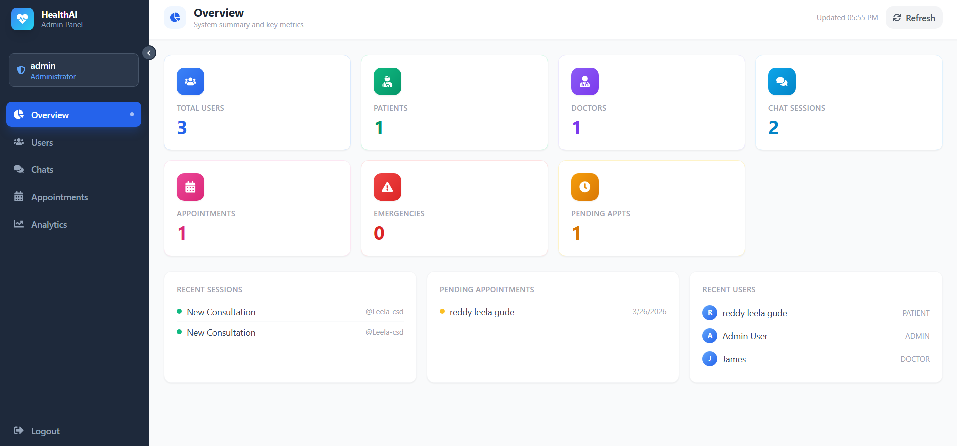
OUTPUT
Admin Page:

Slide 23
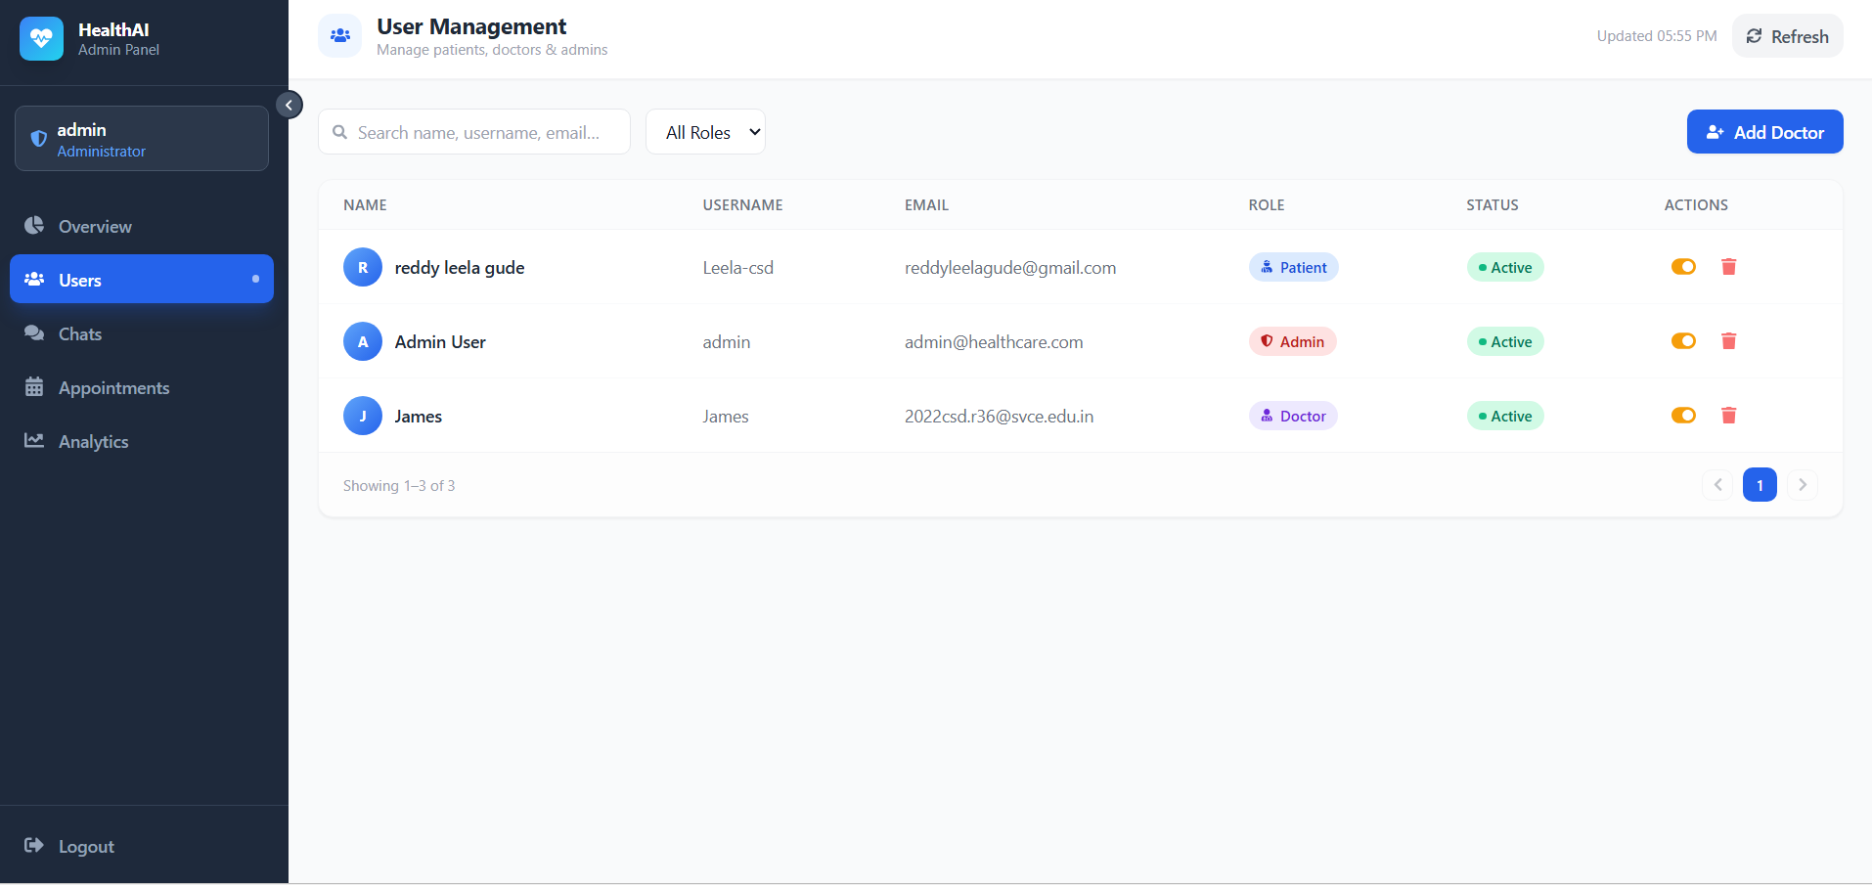
OUTPUT
Admin Page:

Slide 24
CONCLUSION
The project successfully develops a full-stack AI-powered healthcare chat assistant using modern technologies like Spring Boot and React.
It provides intelligent and real-time responses using advanced AI models such as Ollama and GPT-4.
The system supports multi-session chat with history, bilingual communication, and voice interaction, making it user-friendly and accessible.
Features like emergency detection and nearby hospital suggestions enhance its practical usability in real-world situations.
Role-based access for patients, doctors, and admins ensures better system management and functionality.
The use of secure authentication and scalable architecture makes the system reliable and efficient.
Overall, this project improves healthcare accessibility, reduces response time, and demonstrates how AI can be effectively integrated into modern healthcare systems.

Slide 25
REFERENCES
A. B. Kumar and R. S. Rao, “Artificial Intelligence Based Healthcare Chatbot Using NLP,” International Journal of Computer Applications, vol. 176, no. 25, pp. 1–6, 2021.
S. Divya, S. Indumathi, and P. Sangeetha, “An Intelligent Chatbot for Healthcare Application,” International Journal of Engineering Research & Technology (IJERT), vol. 9, no. 6, pp. 234–239, 2020.
M. S. Islam, A. Hasan, and M. Rahman, “AI-Based Medical Chatbot Using Machine Learning,” International Journal of Advanced Computer Science and Applications, vol. 11, no. 4, pp. 112–118, 2022.
A. Abirami and S. S. Chitra, “Disease Prediction System Using Machine Learning,” International Journal of Scientific Research in Computer Science, vol. 8, no. 3, pp. 45–50, 2019.
R. S. Sutton and A. G. Barto, Introduction to Machine Learning in Healthcare, MIT Press, 2018.
R. Smith and J. Doe, “Optical Character Recognition for Medical Prescription Analysis,” IEEE International Conference on Image Processing, pp. 456–460, 2019.
T. M. Mitchell, Machine Learning, McGraw-Hill, New York, 2017.

Slide 26
REFERENCES
Research papers and articles related to:
AI in Healthcare
NLP-based Chatbot Systems
Disease Prediction using Machine Learning
Online medical symptom datasets used for training and testing (as applicable).
Confusion Matrix and Accuracy evaluation methods from standard ML textbooks/tutorials.

Slide 27


